Slide 1

Data and Information Retrieval 220CT
Data preprocessing for data mining
Focused on Data Mining: Concepts and Techniques

Slide 2
Overview
Data sources
Data Quality
Data Cleaning
Data Integration
Data Transformation
Data Reduction

Slide 3
Data Sources
Name some sources of data

Slide 4




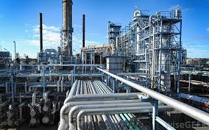
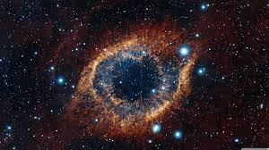



Data Sources

Slide 5



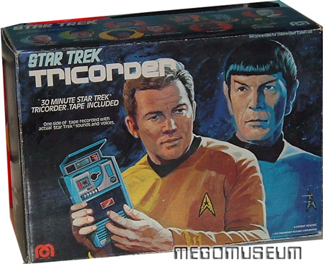

Data Collection Approaches

Slide 6
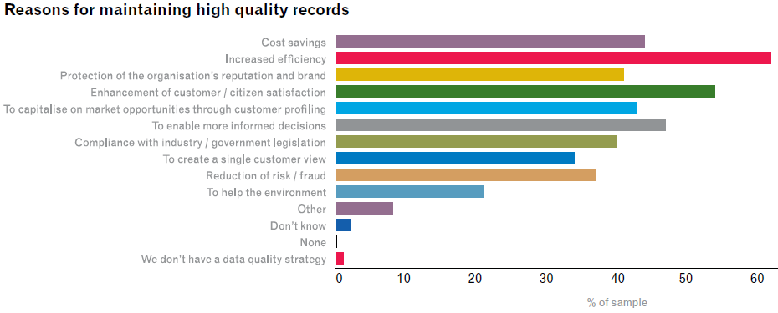
Why does data quality matter?

Slide 7
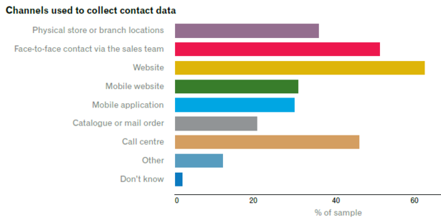
Where do get data from

Slide 8
Data Quality
A critical or distinguishing characteristic necessary for data to be fit for use.
Your data mining is unlikely to work if he data does not mean what they think it does
Data quality issues can be expensive and time consuming to overcome

Slide 9
Data Quality
Data quality methodology should relate to why we are using the data, improve the process of data collection and analysis and can be measured to show how well it works.

Slide 10

Measures of Data Quality
Validity
Completeness
Precision
refers to the closeness of two or more measurements to each other.
Refers to how well the data measures what it is purported to measure.
Consistency
Uniformity
the data is available when required.
Reliability
Integrity
Timeliness
Notes:
The overall intent of any data integrity technique is the same: ensure data is recorded exactly as intended (such as a database correctly rejecting mutually exclusive possibilities,) and upon later retrieval, ensure the data is the same as it was when it was originally recorded
Data completeness refers to an indication of whether or not all the data necessary to meet the current and future business information demand are available in the data resource
Data Precision refers to the closeness of two or more measurements to each other. Using the example above, if you weigh a given substance five times, and get 3.2 kg each time, then your measurement is very precise.
Data Consistency refers to the usability of data; we want data to be constant in time and for us to be capable of using and showing them in different ways without changing their structure.
Data timeliness the data is available when required.
Data integrity is the maintenance of, and the assurance of the accuracy and consistency of, data over its entire life-cycle
Data reliability is a state that exists when data is sufficiently complete and error free to be convincing for its purpose and context.
Uniformity implies consistency in lack of variation between the items being compared, over a long period and across a wide range.
Validity refers to how well the data measures what it is purported to measure.

Slide 11
Loss of Data Quality
At the time of collection
During documentation
During storage
During analysis
At time of presentation
And what they are used for

Slide 12

Data Quality - Who is your Data Quality Expert?

Slide 13
Data Quality Example

Slide 14
Over to you
You are going to collect samples of animals from the sea bed, store them and analysis them to see if there has been any change in the species found there due to global warming. Design an approach to maintain quality of the data collected and the findings presented.
Consider how in this experiment data quality can be compromised

Slide 15
Data Preprocessing
Any type of processing performed on raw data to prepare it for data mining.
Typically preliminary data mining activity by converting data in a form that is easy to use

Slide 16
Data Preprocessing
There are a number of different approaches and methods used for data preprocessing
  Selecting a representative subset from a large population of data;
  Altering the raw data to create the single input
  denoising, normalization etc

Slide 17
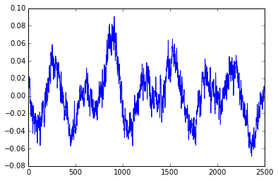
Why do we preprocess data
Data we collect is not always clean
  Responses missing: address= “”
  Data is noisy: spurious data, measurement error and background data containing errors or outliers

Slide 18
Why do we preprocess data
  Inconsistent data: containing discrepancies e.g., post code = NG157AA Address =“Coventry”
  or causes by data from different sources eg age 22 from one source or between 18-25 from another.
Without good quality data we are unlikely to find good quality mining outcomes.

Slide 19
Data problems
Problem | Dirty Data
Illegal Value | Dataofbirth=25.25.05
Uniqueness not mantained | Id=011 name= “Mark Elshaw” Id=011 name=“Shila Hamzepur”
Referential integrity violation | Name=“Smith” Dept =22 Department 22 does not exist

Slide 20
Data problems
Problem | Dirty Data
Missing values | Income =
Misspelling | City = “berllin”
Data in wrong place | City=“Brazil”
Transposition | Name= “M. Elshaw” Name=“Elshaw M.”
Duplicated records | Name= “ M. Elshaw Name=“Mark Elshaw”

Slide 21
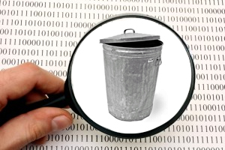
Garbage in Garbage out

Slide 22
Major tasks in preprocessing
Data cleaning: Fill in missing values, smooth noisy data, identify or remove outliers, and resolve inconsistencies
Data integration: Integration of multiple data sources
Data transformation: Techniques to transform data
Data reduction: Obtains reduced representation in volume but produce simular results

Slide 23
Data Transformation
Data Cleaning
Preprocessed data
Data Integration
Data Reduction

Slide 24

Data Cleaning

Slide 25
Data Cleaning
Data cleaning, or data scrubbing is the process of identifying and correcting (or removing) incorrect values.
Relates to identifying incorrect, inaccurate, irrelevant, etc. parts of the data and then replacing, modifying, or deleting this dirty data.

Slide 26
Data Cleaning
Data cleaning tasks – this routine attempts to
  Handling missing values
  Identify outliers and smooth out noisy data
  Correct inconsistent data
  Resolve redundancy caused by data integration from multiple sources

Slide 27
Missing data
Missing data may be due to: equipment problems, problems with how it fits in with other data, data never recorded

Slide 28
How to deal with missing data
Fill in the missing value manually
Fill in it automatically
  with the attribute mean,
  the attribute mean for the class
  the most probable value: inference-based such as Bayesian formula or decision tree

Slide 29
How to Overcomes Noisy Data
Binning method
Clustering: Similar values are organized into clusters.
Values that fall outside of clusters considered outliers.
Inspection data using computers and humans
Regression: Smooth data by using regression.

Slide 30
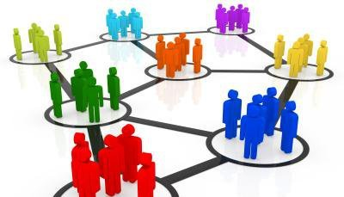
Removing Noise: Clustering

Slide 31
Education and Data cleaning
  “It is far cheaper and more efficient to prevent an error from happening, than to have to detect it and correct it later. It is also important that when errors are detected, that feedback mechanisms ensure that the error doesn’t occur again during data entry, or that there is a much lower likelihood of it re-occurring.”
  Arthur D. Chapman (Australian Biodiversity Information Services)

Slide 32
Data Integration
Combines data from multiple sources into a coherent store
Entity identification problem:
  Identify real world entities from multiple data sources, e.g., Bill Smith = William Smith
Identify and overcome data value conflicts
  For the same real world entity, the attribute has different values

Slide 33
Data Integration as a Service

Slide 34
Data Transformation
Smoothing: remove noise from data
Aggregation: summarization
Normalization: scaled to fall within a small, specified range
New attributes constructed from the given ones

Slide 35

Normalisation Example
min-max normalization
Normalise between 0 and 2, maximum value is 540, minimum value 20, current value is 420
((420-20)/(540-20))*(2-0)+0=1.54

Slide 36
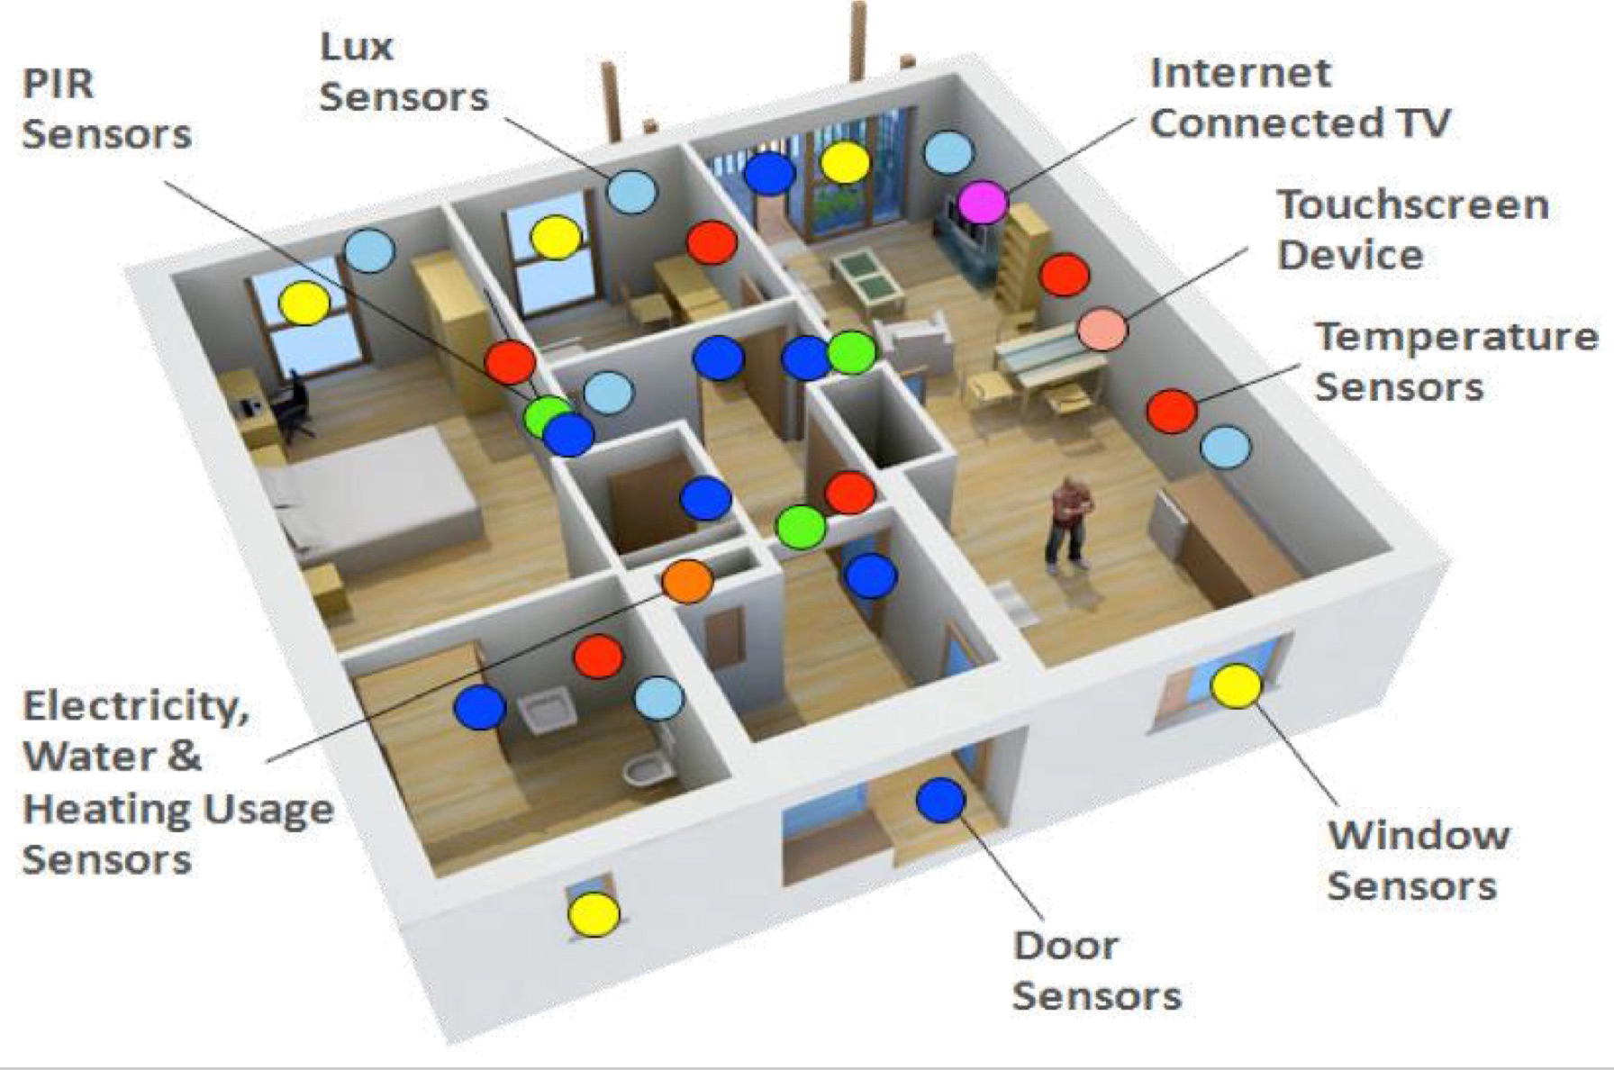

Slide 37
How would we transform this data to make it more meaningful
We have a sensor that indicates if an senior citizen is in a room or not. A measurement is made every 5 second
Time | Kitchen | Bedroom | Bathroom
2:00:05 | Y | N | N
2:00:10 | Y | N | N
 |  | …
8:23:35 | N | Y | N

Slide 38
Data Reduction
Why data reduction?
  A database/data warehouse may store terabytes of data
  Complex data analysis/mining may take a very long time to run on the complete data set

Slide 39
Data Reduction
Data reduction strategies
  Dimensionality reduction — e.g., remove unimportant attributes
  Data Compression
  Numerosity reduction — e.g., fit data into models

Slide 40

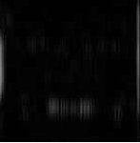


Data Compression
Which emotion?

Slide 41
Filters in WEKA

Slide 42
Summary
High quality data mining needs data that is useful
To achieve this we often need to perform some preprocessing on the data
Preprocessing combines data cleaning, data integration, data transformation

